Slide 1

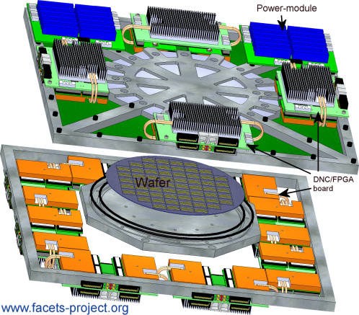
The FACETS
Demonstrator
M. A. Petrovici
University of Heidelberg
Code Jam 3
Freiburg, 09.10.2009

Slide 2
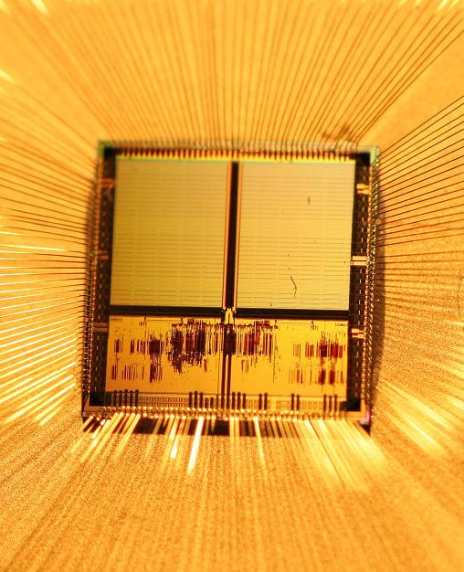
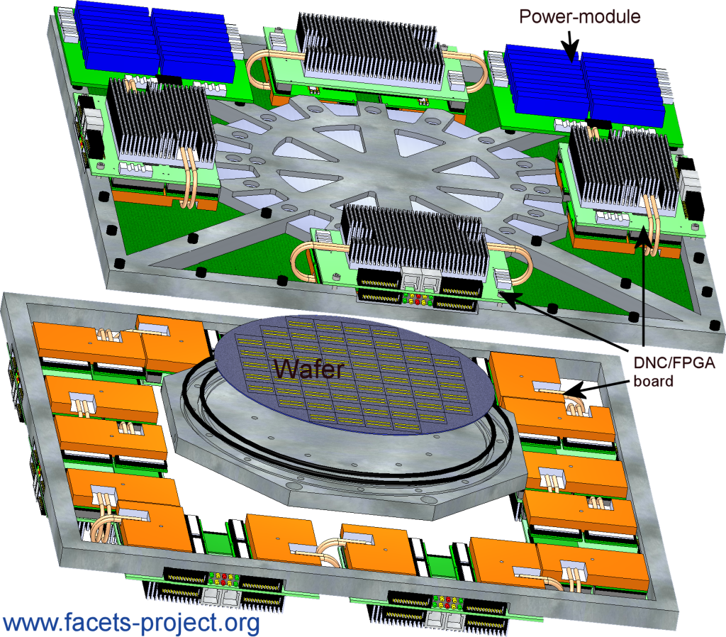
The FACETS Hardware
Stage 1: The Spikey Chip
Stage 2: Waferscale integration
384 neurons
10⁵ synapses
16 ⋅ 10⁴ neurons
4 ⋅ 10⁷ synapses

Slide 3
The FACETS Demonstrator is…
... a collection of cortical neural network models
emulated with the FACETS wafer-scale hardware *
* as long as not yet available: dedicated executable system specification
...exhibiting functionality that can be demonstrated
...written in PyNN
...computable with established software simulators
(for verification, performance evaluation etc.)

Slide 4
Why bother ?
Reviewers & community are interested in:
Ability of the wafer-scale hardware system to serve as a flexible research tool in modeling neuroscience:
– despite hardware constraints, relevant experiments possible
– crucial interplay between hardware and software
– massive complexity of hardware configuration space can be handled
by intelligent software
– operability by non-hardware experts
Ability of FACETS to fruitfully cooperate:
– Demonstrator is actively developed by UHEI, TUD, KTH, UNIC, ALUF, INCM
– hardware neuron and synapse models: result of discussions.
FACETS has participated in their original development, e.g. EPFL.

Slide 5
Why not wait for the hardware ?
Testing and evaluation of all involved software layers
Virtual hardware allows to
– test software before hardware is available
– test without possible hardware-specific problems
– provide a preliminary PyNN module for off-line testing of experiments
Verification of possible hardware changes
e.g. optionally insert detailed HICANN model
⇒ Important test-bench for preparation work

Slide 6
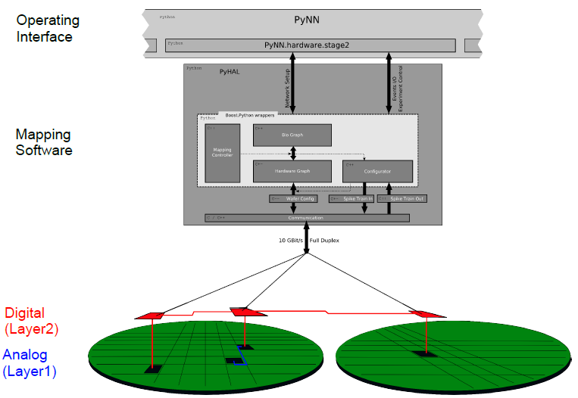
Simulating the emulator

Slide 7
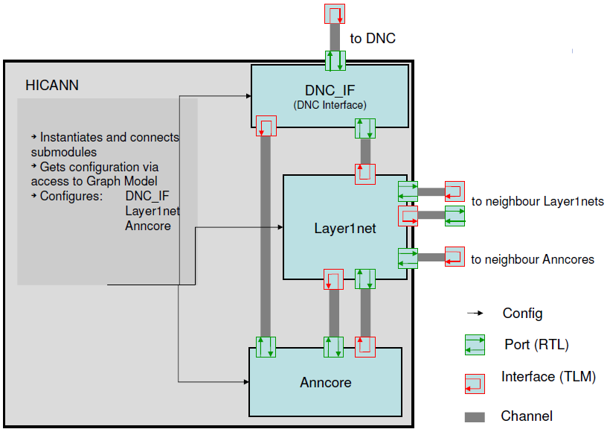
Simulating the emulator

Slide 8
Experiments and demonstrations (to-do list…)
Evaluation of the involved software layers
• show full support of low-level and object-oriented PyNN API
• quantify performance of the mapping and routing algorithms
– Execution time, memory consumption etc as function of network
size, parameter heterogeneity, applied optimization strategies etc.
– Neuron and synapse loss as function of …
– Histogram of layer1 hops as function of …
Demonstrate correct functionality of the virtual hardware
• Unit tests

Slide 9
Experiments and demonstrations (to-do list…)
Model performance: Influence of hardware-specific
imperfections or inhomogeneities
• neuron and synapse parameters (e.g. 4-bit weights, limited precision),
signal transmission delays, …
– comparison software vs. (virtual) hardware
– incorporate hardware-specific distortions into software model
• automatically extracted: “post-mapping” PyNN scripts that reflect
mapping distortions

Slide 10
The Demonstrator models (so far)
• A layer 2/3 attractor memory
(by KTH, Krishnamurty / Lansner)
• A synfire chain model
(by INCM and ALUF, Kremkow / Aertsen / Masson)
• A model of self-sustaining cortical AI states
(by UNIC, Davison / Destexhe)
• Upcoming: Two-layer model by UNIC
All written in PyNN, all scalable, basic versions can be mapped to
hardware without synapse loss

Slide 11
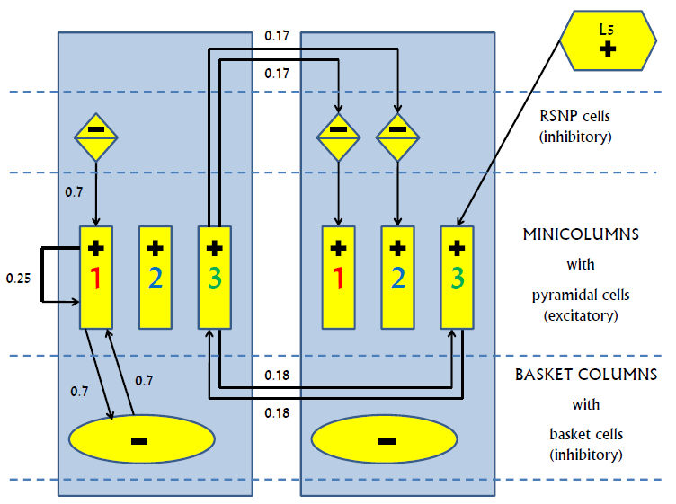
Attractor memory schematic

Slide 12
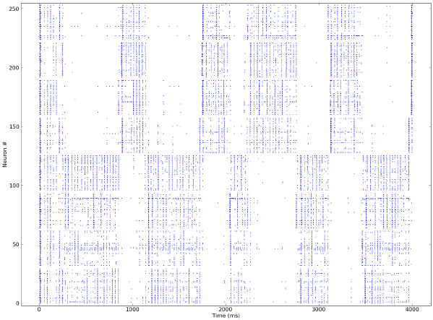
Attractor memory (NEST): 2 attractors

Slide 13
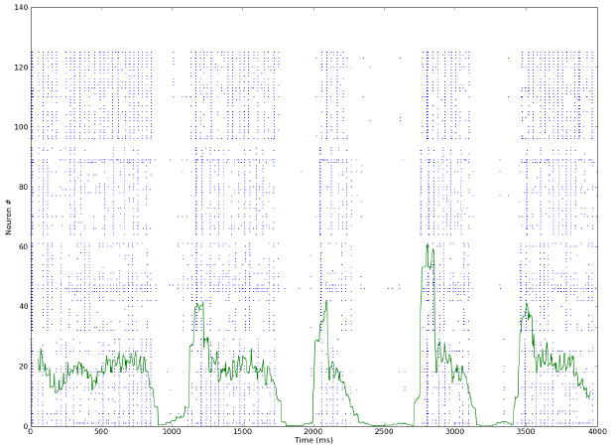
Attractor memory (NEST): pyramidal spike rate

Slide 14
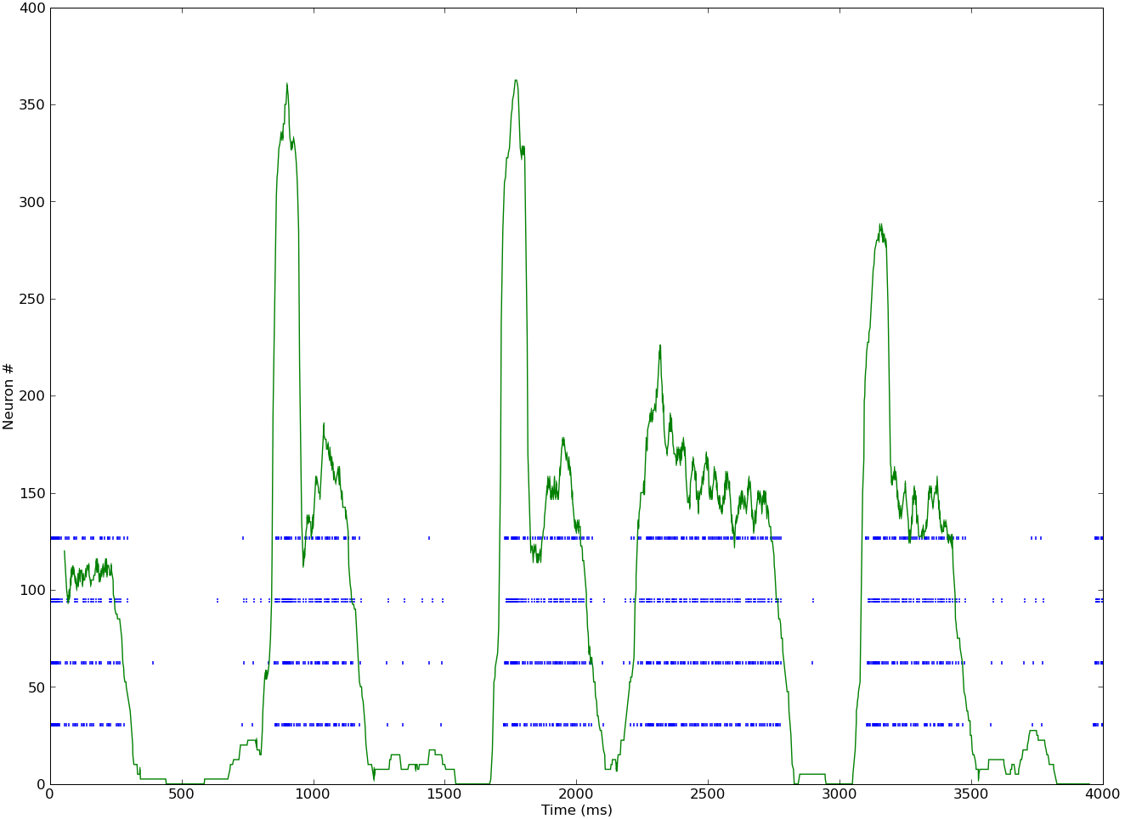
Attractor memory (NEST): RSNP spike rate

Slide 15
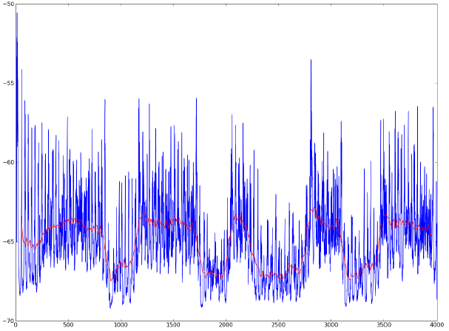
Attractor memory (NEST): average membrane potential
attractor 1

Slide 16
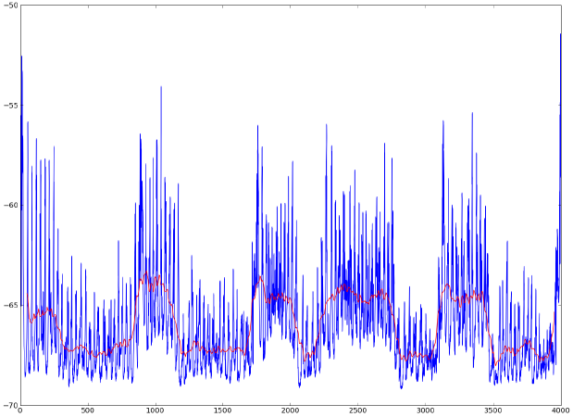
Attractor memory (NEST): average membrane potential
attractor 2

Slide 17
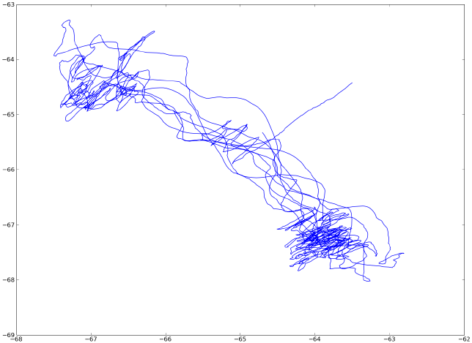
Attractor memory (NEST): phase diagram

Slide 18
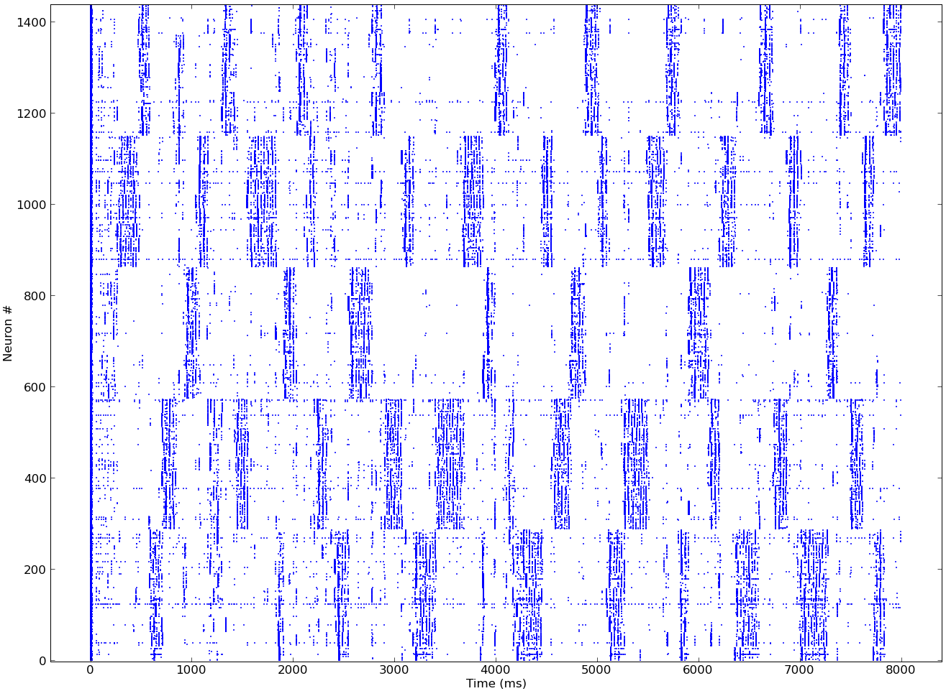
Attractor memory (NEST): 5 attractors

Slide 19
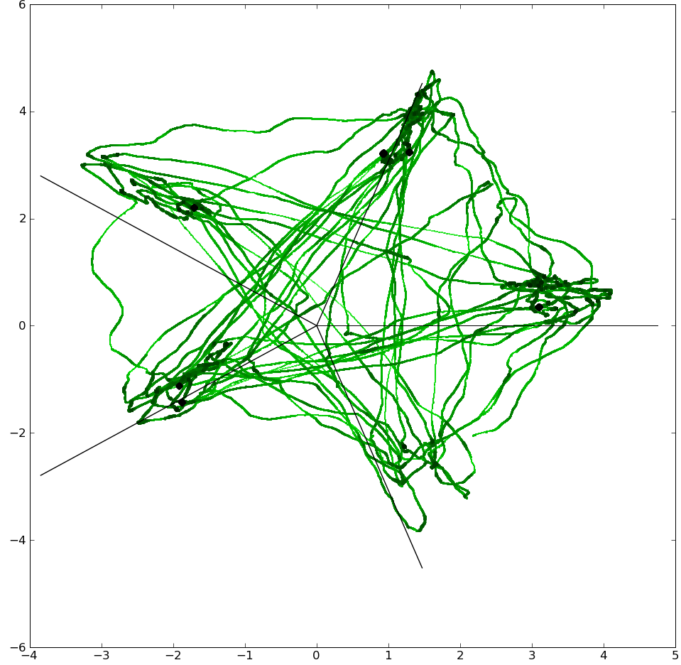
Attractor memory (NEST): “advanced” phase diagram

Slide 20
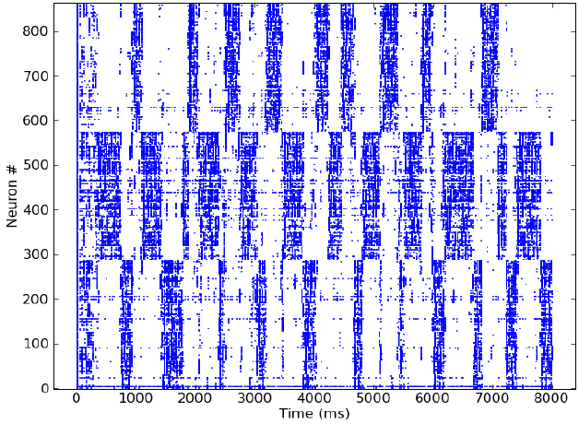
Attractor memory (NEST): 0% synaptic loss

Slide 21
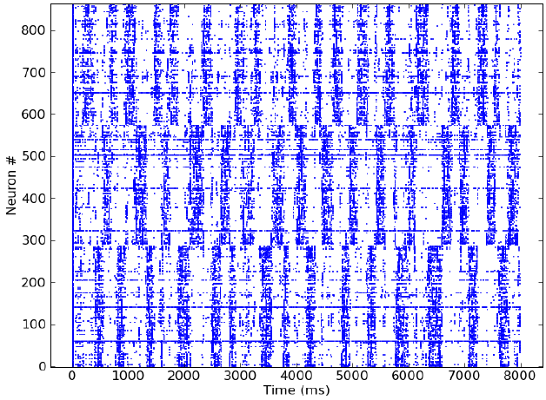
Attractor memory (NEST): 20% synaptic loss

Slide 22
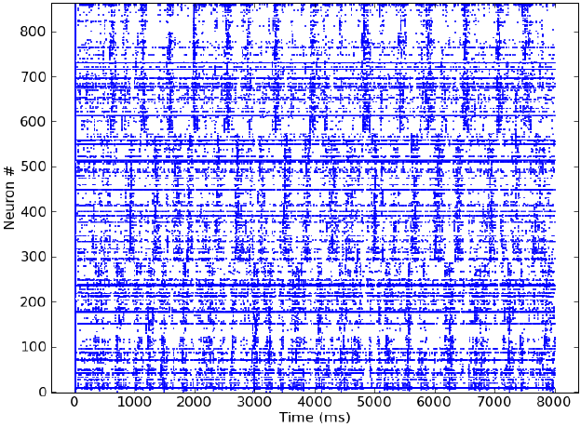
Attractor memory (NEST): 40% synaptic loss

Slide 23
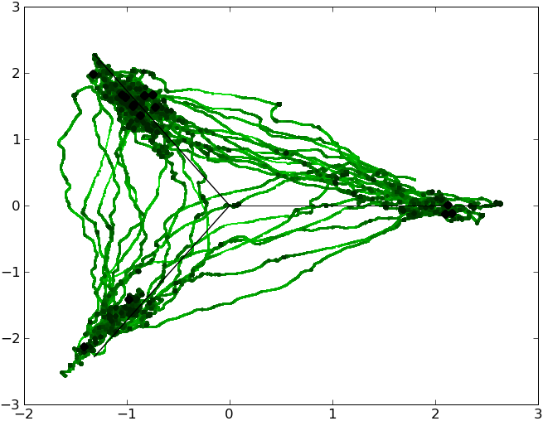
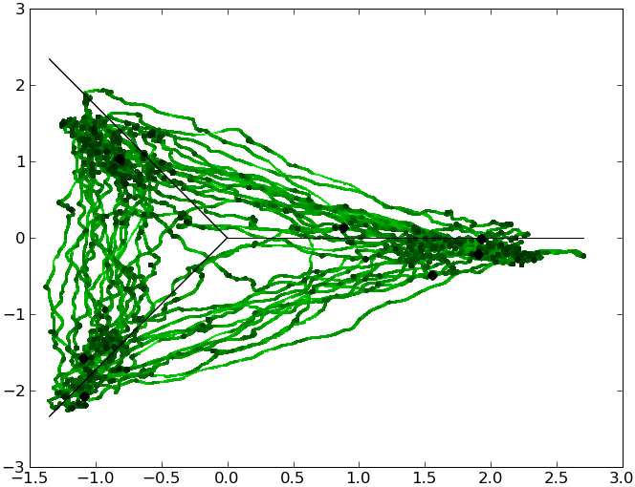
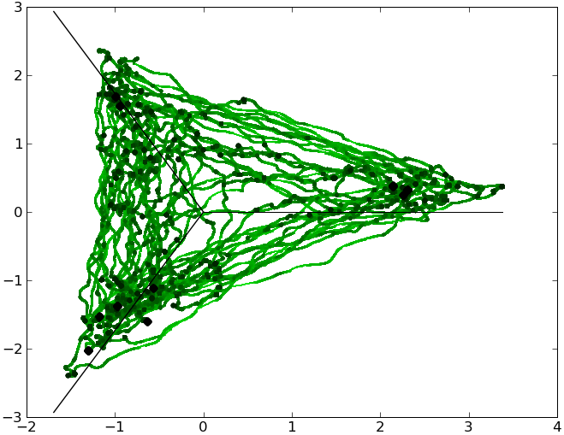
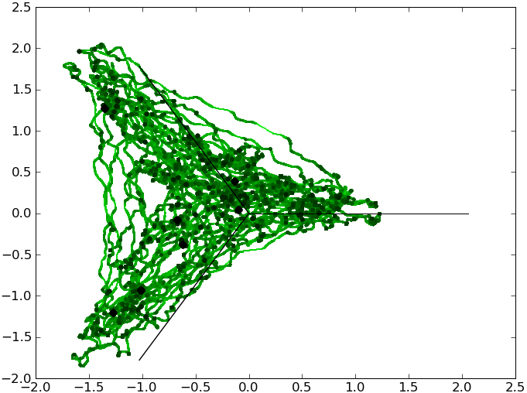
Attractor memory (NEST): phase diagrams
0% loss
10% loss
25% loss
40% loss

Slide 24
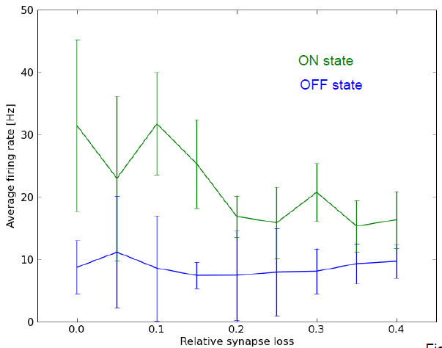
Attractor memory (NEST): firing rates

Slide 25
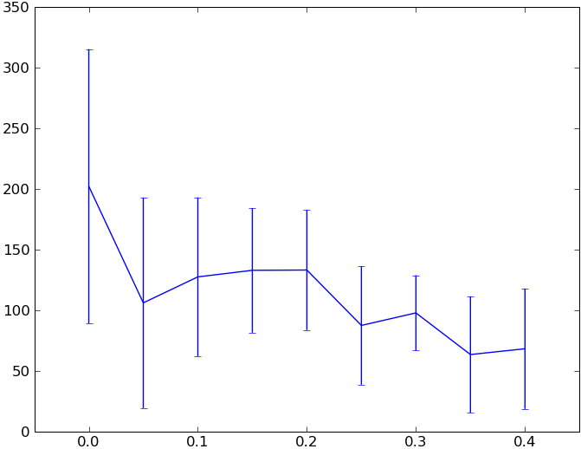
Attractor memory (NEST): attractor dwell times
dwell time [ms]
relative synaptic loss

Slide 26
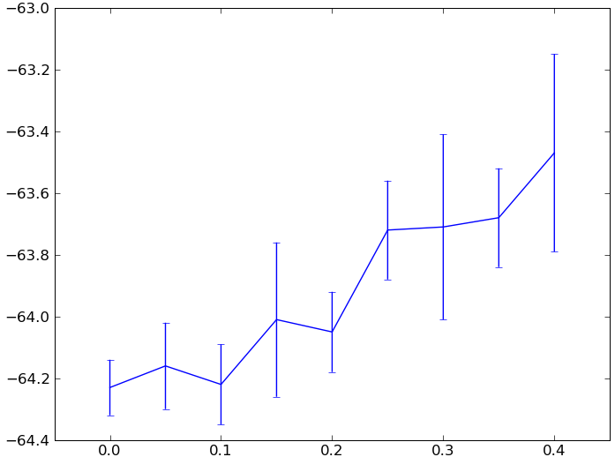
Attractor memory (NEST): threshold voltage
threshold voltage [mV]
relative synaptic loss

Slide 27
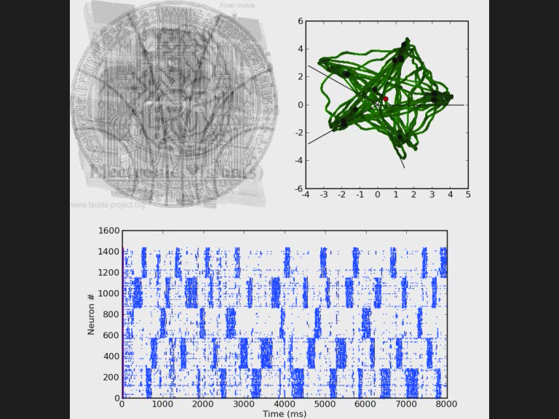
Attractor memory (NEST): pattern completion

Slide 28
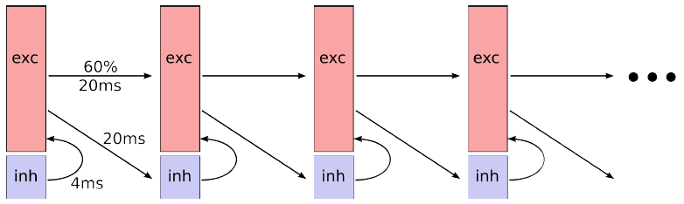
Synfire chain schematic

Slide 29
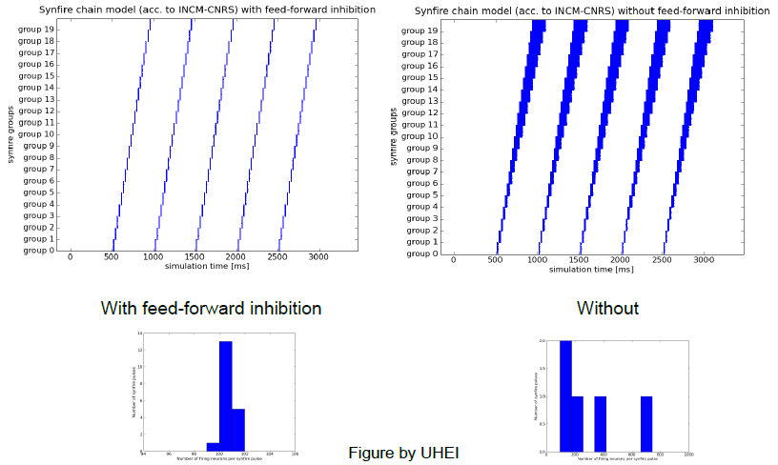
Synfire chain simulations (NEST)

Slide 30
Technical infrastructure and visibility
● Wiki documentation (internal)
● Full code available in SVN repositories
● Experimental results in BSCW repository
● Tele-conferences
● Publications

